Slide 1
Blackjack By Bender!
(By Nichlas)
Let’s go gambling!

Slide 2
Overview
Objective
Requirements
Implementation
Basic Game Loop
Testing
Reflections
Demo

Slide 3
Defining Requirements
MVP (Essential)
Nice-To-Have
End states (Bust, Blackjack, Push)
All cards have a numerical value
Value of Ace is conditional
Cards are unique
Player is able to write an input to the console (Hit/Stand)
Splitting is an option
The player has a number of chips, with which they can bet, using console input
The player can Double Down or Surrender as an optional input

Slide 4
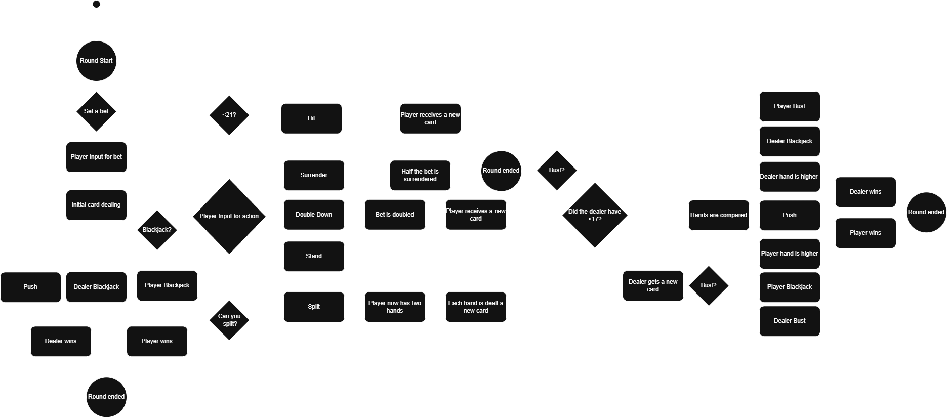
Implementation - Basic Game Loop

Slide 5
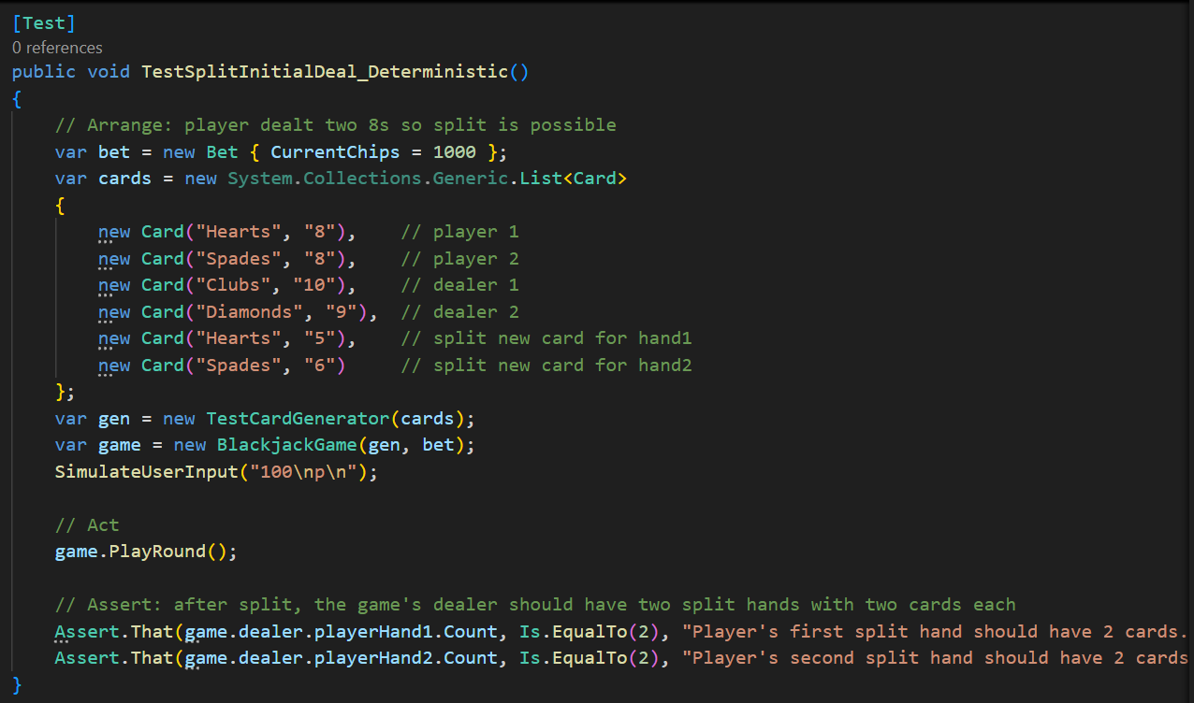
Implementation - Testing
Unit Testing
NUnit
Simulated inputs
Test cases
Complete all inputs
Push
Blackjack detection
Invalid inputs
Deterministic cards

Slide 6
Reflections
Challenges / Pitfalls
Future works
Splitting
Hand separation
New end states
Bug fixing
Infinite rounds
Blackjack detection
Unit testing
New experience
More test cases
Test more methods
Find more edge cases
Strings vs Enums
Type safety
Performance
OOP readability

Slide 7
DEMO
Who wants to go gambling?

